Slide 1

AGRI AIUTO
S.Ishrath Unnisa [154G1A0533] Batch No: A2
K.Bhavitha [154G1A0514]
G.Bhuvaneswari [154G1A0516] Project Guide:
P.Baba Fakruddin [154G1A0508] G.Hemanth Kumar Yadav M.Tech
Assistant Professor
Srinivasa Ramanujan Institute of Technology
Department of Computer Science & Engineering

Slide 2
Contents:
Abstract
Problem Definition
Project Planning
Literature Survey
Requirements
References

Slide 3
Abstract
The "AGRI AIUTO" application delivers the detail information about which crop to grow in which season and which crop is suitable for that particular soil in which the farmer wishes to start. This application helps the farmer to choose the perfect pesticide in order to maintain a healthy crop and also provides the climatic conditions so that we can select the seasonal crop to get benefited. User sends their problem by uploading the image and any other user can respond through text or image. Now-a-days mobile being a common device, with this application we aim to make it friendly for farmers

Slide 4
Problem Definition
Agri Aiuto is to keep a farmer updated with all the information related to crop, pesticides ,insecticides, Merchant and Climatic conditions.
Agri Aiuto helps the farmers to interact with the experts and take suggestions from them.

Slide 5
Project Planning
Days | Target | Status
(7-02-2019 to 10-02-2019) | Design of UML diagrams | Completed
(11-02-2019 to 15-02-2019) | Literature Survey, Screen designing | Completed
(16-02-2019 to 23-02-2019) | Implementation | In Progress
(24-02-2019 to 27-02-2019) | Testing | Not yet completed
(28-02-2019 to 8-03-2019) | Output and Documentation of project | Not yet completed

Slide 6
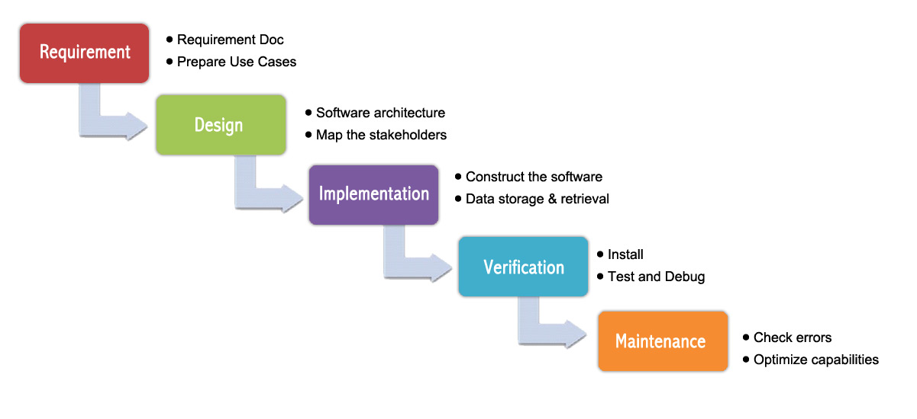
Software Model

Slide 7
Continued…
Modules
User
Login through mobile number and enter OTP verification.
Selecting the Language.
Selection of crop and details.
Storing the details of crop in favorites .
Selection of Merchants and viewing their details.
Selection the date for viewing the weather.
Selection of Pesticide and viewing their details.
Upload the text or image for suggestions and responding to other users.

Slide 8
Continued…
Admin
Login through mobile number and enter OTP verification.
Selecting the Language.
Updating the data about the crop, merchants, pesticides and season.
Uploading and giving message to the suggested person.

Slide 9
Literature Survey a. Existing System
Plantix
My Plantix is the agricultural app in India in English which has been specifically designed for Indian Farmers.
This agriculture app in India will make sure every farmer in India has access to the latest agricultural technology and techniques so that they are able to rise health crops and in turn contribute to a health living of the entire nation while doing profitable farming.

Slide 10
Continued…
Limitations
Information about the pesticides and seasonal data is not provided.
Information of Merchants and their availability is not provided.
Request for more user details in order to access the application.
Provided in only one language.

Slide 11
Continued..
Agro App
Agro App is a mobile application that is basically built on
the idea that an app to provide the information related to
crop, pesticides and financial sector.
It contains online paying or selling of the crop.

Slide 12
Continued
Limitations
The Information of crops and soils is not provided properly.
Usage of Pesticide is not mentioned.
Illiterate people is unable to understand the information about the app.
No Suggestions from other individuals.

Slide 13
Proposed System
User Authentication by mobile number for flexibility.
It provides the information about which crop to grow in which soil based upon the season to gain profit.
Storing the list of the crop in favorites for revisiting them.
It provides information about the merchants.
Information about the pesticides and their usage.
Suggestions from other individuals either by text message or image.
App requires an Active Internet Connection for fetching the information.

Slide 14
Continued…
Making the user understand the information using Text to Speech.
Weather Forecasting based on the region.

Slide 15
Requirements
Hardware requirements:
RAM Capacity: 8GB or 6GB
Hard disk Capacity:2 GB or 4GB
Processor:i3 or above
Software requirements:
Operating Systems – Windows7/8/10(32-bit or 64-bit)
Platform – Android Studio 3.3
Programming in- Java, Extensible Markup Language(XML)

Slide 16
References
https://ieeexplore.ieee.org/document/6965213/
http://ieeexplore.ieee.org/document/7358528/
http://ieeexplore.ieee.org/abstract/document/8073690/

Slide 17
Thank you
Queries
?

